Slide 1

Data Structures
&
Algorithms
Lab 2

Slide 2
C++ Functions
Task
Write a C++ program to find the Power Calculation.
Write a C++ program to find the largest three elements in an array.

Slide 3
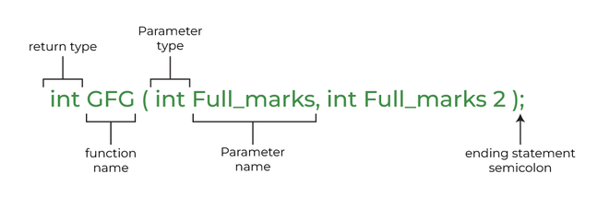
Syntax
void myFunction() {
// code to be executed
}

Slide 4
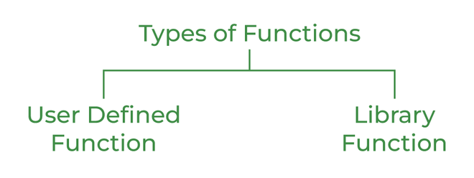
Types of Functions

Slide 5
Example1
Inside main, call myFunction():
// Create a function
void myFunction() {
cout << "I just got executed!";
}
int main() {
myFunction(); // call the function
return 0;
}

Slide 6
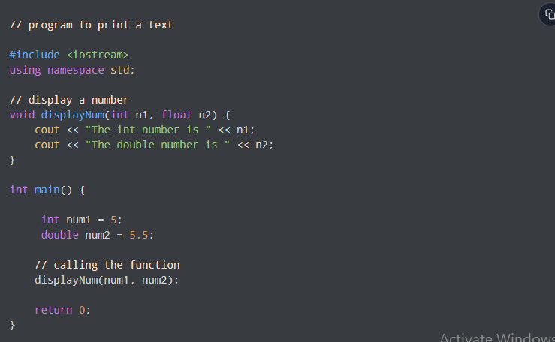
Example 2: Function with Parameters

Slide 7
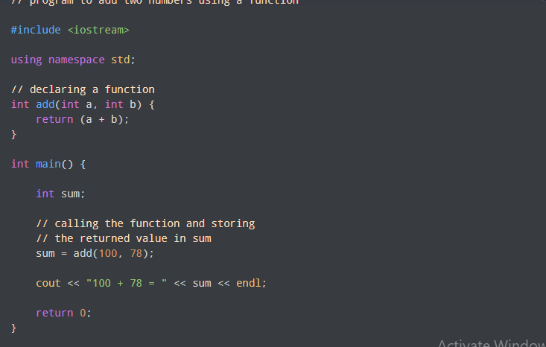
Example 3: Add Two Numbers

Slide 8
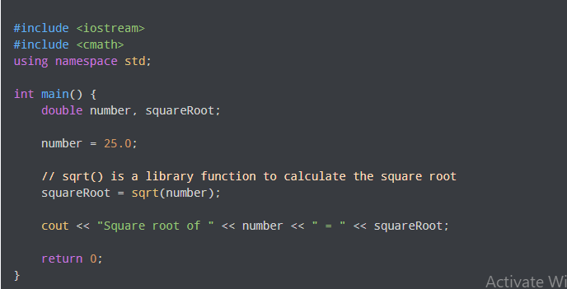
Example 4: Find the Square Root of a Number

Slide 9
Write a C++ program to find the largest three elements in an array

Slide 10
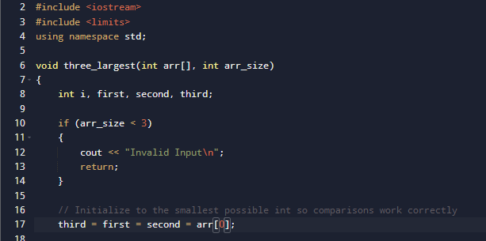

Slide 11
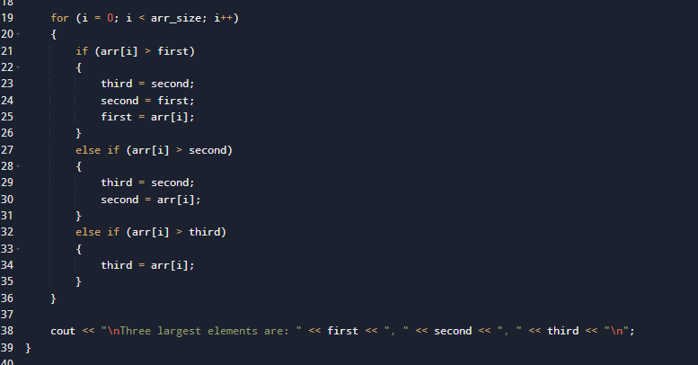

Slide 12
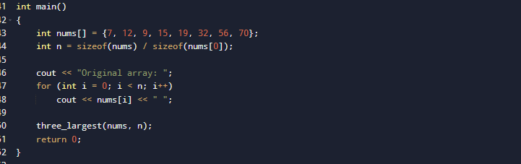
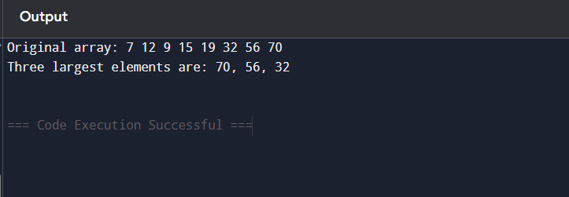

Slide 13
Structures in C++
Syntax
struct name
{
type1 mem1;
type2 mem2;
...
};

Slide 14
Initialize Structure Members
struct Point
{
int x = 0;
int y = 0;
};

Slide 15
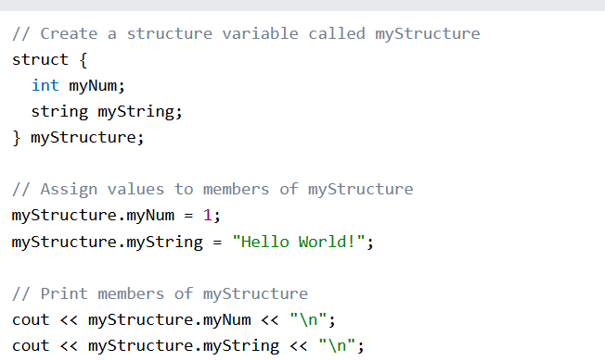
Access Structure Members

Slide 16
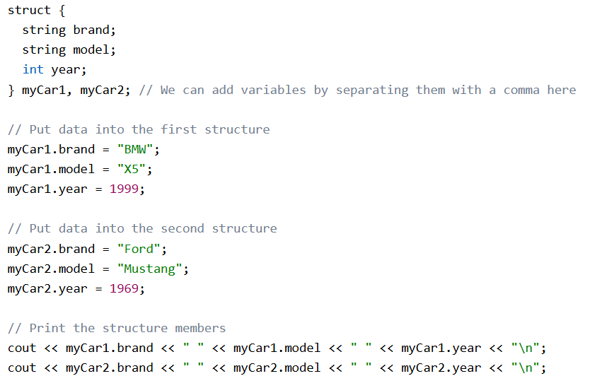
One Structure in Multiple Variables

Slide 17
When we pass a structure to a function, it can be passed in two primary ways:
Call by Value — A copy of the structure is made. Changes inside the function do not affect the original structure.
Call by Reference — A reference (or pointer) to the structure is passed. Changes inside the function affect the original structure.

Slide 18
Exercise 1: Passing a struct by Value
Write a C++ program that defines a structure named Student containing the following members:
        name (string)
        age (integer)
        gpa (float)
Then, create a function called modifyByValue() that takes a structure by value and modifies its members.
Print the values before and after calling the function.
Observe whether the changes inside the function affect the original variable.

Slide 19
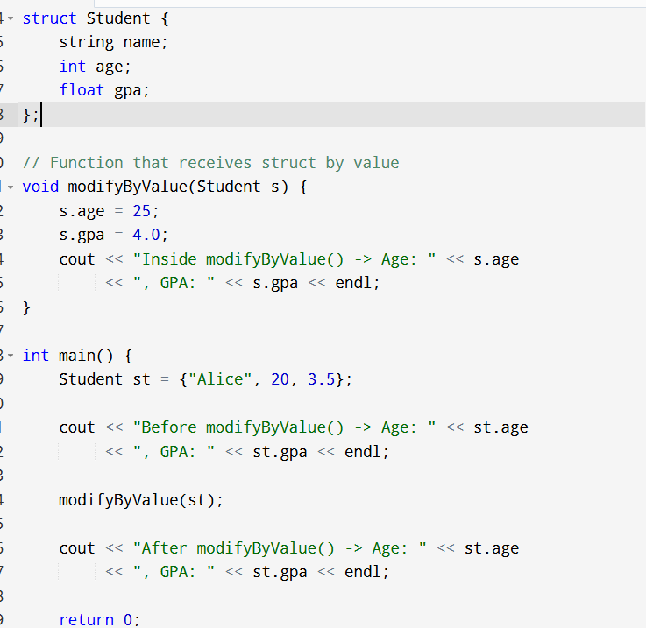

Slide 20
Exercise 2: Passing a struct by Reference
Modify the previous program so that the function modifyByReference() receives the structure by reference using the & symbol.
Change the values inside the function and print the results before and after calling it.
Compare the behaviour to the first example.

Slide 21
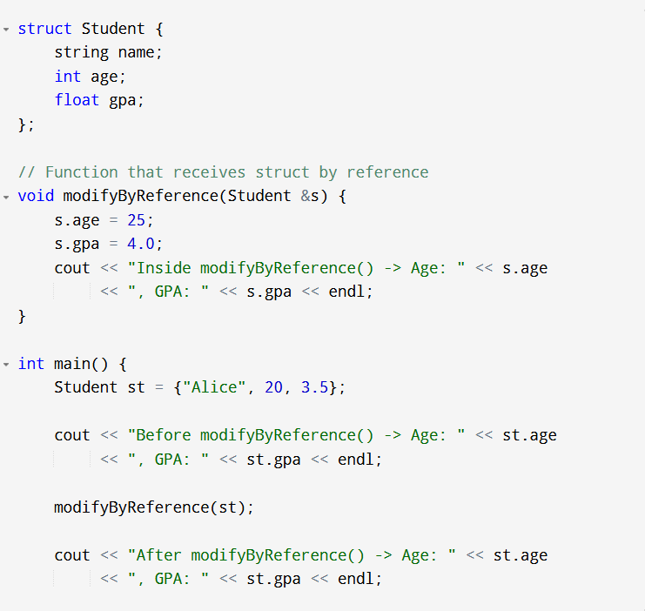

Slide 22
Thank You

